Slide 1

Risk Management in
Pre-provision Net Revenue Forecasting
Prepared by: Kamil Stajerski, Marcin Nowik
Date: 27/04/2026

Slide 2
Presentation outline
Business Overview | 03
Regulations | 07
Risk Management | 10
Model Validations | 16
References | 21

Slide 3
Business Overview

Slide 4
Finance (PPNR) Introduction
PPNR Definition
Pre-provision Net Revenue (PPNR) is the net revenue of the bank before adjusting for loss provisions.
It is defined as the sum of Net Interest income and Non-Interest income less expenses and loss provisions.
Net Interest Income: Revenue generated from interest-bearing assets and the cost of servicing liabilities
Net Non-interest Income: Revenue generated from the non-core activities by the banks and financial institutions and operating expense
Interest Income
Interest Expense
Non-interest Income
Non-interest Expense
PPNR
‒
+
‒
=
Interest-bearing Assets:
Loans
Securities
Mortgages
Interest-bearing Liabilities:
Customer deposits
Bonds
Fees:
Trading
Brokerage
Annual fees
Monthly account service charges
Inactivity fees
Check and deposit slip fees, etc.
Operating expense:
Employee Compensation
Salary
Benefits
Bonuses
Processing / Software
Occupancy (Plant, Property & Equipment)

Slide 5
Products and Services
From Balance perspective, main products consist of Commercial and industrial (C&I) Loans, Commercial Real Estate (CRE) Loans, and Wealth and Personal Banking (WPB) Mortgages.
C&I Loans are the largest exposure. They are loans that are provided to business to support their business operations, expansions, inventory managements and others, such as Corporate Loans.
CRE Loans are loans that specifically designed to fund the purchase, refinancing, or development of commercial properties. These loans are typically used by businesses, investors, and developers to acquire or maintain income-generating properties.
WPB Mortgages offers products to globally mobile, mass affluent individuals.
From NIR perspective, main services consist of Investment Banking (IB) products and Treasury Services, and WPB revenue
IB Revenue including fee income from services of Debt Capital Markets (DCM, such as corporate bond) and Equity Capital Markets (ECM, such as IPO) issuance, advisory, syndicated loan.
Treasury Services Revenue include GPS - Global Payments Solutions. It helps clients to move their money internationally, manage their balances and unlock cash flow and treasury insights.
GTRF – Global Trade And Receivables Financing, includes fees on providing trade finance such as Letter of credit fees and receivable financing fees.
GLCM – Global Liquidity and Cash Management, includes fees on cash management products and services such as global payments platform.
IWPB Revenue include fees such as asset management, ATM, account maintenance, credit card overdraft.
Global Private Banking Wholesale loans are provided to high-net-worth individuals and families and their related entities.

Slide 6
Business Overview
Critical Process and Decisions – Models’ Usage
Finance Models are used to forecast Loan Balance and Non-Interest Revenue (NIR) generated by those businesses.
And they are mainly used in General Stress Testing exercises such as CCAR, PRA, and Strategic Planning. The outputs are submitted to assess the forward-looking capital adequacy.
CCAR (Comprehensive Capital Analysis and Review) is a US Federal Reserve supervisory stress testing and capital planning programme for large banks and bank holding companies.
It assesses whether a bank has:
Enough capital to absorb losses under severely adverse economic scenarios
Robust capital planning processes (governance, risk identification, modelling, controls)
The ability to continue lending and operating through stress while meeting regulatory capital requirements
In practice, banks project key items (e.g., losses, revenues, expenses, and capital ratios) over a multi-year horizon under Fed-provided scenarios, and the Fed uses the results to evaluate capital adequacy and planned capital actions (e.g., dividends, buybacks).
CCAR uses Federal Reserve–defined macroeconomic scenarios each cycle. The standard set is:
Baseline: a consensus-style outlook (not a stress), used mainly for comparison.
Adverse: a moderate downturn scenario (severity varies by year).
Severely Adverse: the main stress scenario used to assess capital adequacy under a deep recession/market shock.

Slide 7
Regulations
Implications to Balance Sheet Profit and Loss modelling

Slide 8
Regulations
FRB : SR 12-7 – Guidance on Stress Testing for banks for Banking Organizations with More Than $10 Billion in Total Consolidated Assets
FRB : SR 11-7 – Guidance on Model Risk Management
FRB : SR 15-19 – Guidance on FRB capital planning expectations for firms subject to Category II or III standards.
FRB : SR 15-18 – Guidance on FRB capital planning expectations for firms subject to Category I standards.
From UK/EU perspective
UK – PRA Stress Test (5-year projections) and SS 1/23
EU – European Banking Authority (EBA) Stress Test (3-year projections)
From US perspective, Finance Models are mainly used in CCAR Stress Testing, therefore key regulations include:
Regulations

Slide 9
Regulations
Extracts from SR11/7, requirements on model development and validation
Model data „The data and other information used to develop a model are of critical importance; there should be rigorous assessment of data quality and relevance, and appropriate documentation. Developers should be able to demonstrate that such data and information are suitable for the model and that they are consistent with the theory behind the approach and with the chosen methodology. If data proxies are used, they should be carefully identified, justified, and documented. If data and information are not representative of the bank's portfolio or other characteristics, or if assumptions are made to adjust the data and information, these factors should be properly tracked and analyzed so that users are aware of potential limitations. This is particularly important for external data and information (from a vendor or outside party), especially as they relate to new products, instruments, or activities.” (Sr11/7, p.6)
Model testing „An integral part of model development is testing, in which the various components of a model and its overall functioning are evaluated to determine whether the model is performing as intended. Model testing includes checking the model's accuracy, demonstrating that the model is robust and stable, assessing potential limitations, and evaluating the model's behavior over a range of input values. It should also assess the impact of assumptions and identify situations where the model performs poorly or becomes unreliable. Testing should be applied to actual circumstances under a variety of market conditions, including scenarios that are outside the range of ordinary expectations, and should encompass the variety of products or applications for which the model is intended. Extreme values for inputs should be evaluated to identify any boundaries of model effectiveness. The impact of model results on other models that rely on those results as inputs should also be evaluated. Included in testing activities should be the purpose, design, and execution of test plans, summary results with commentary and evaluation, and detailed analysis of informative samples. Testing activities should be appropriately documented.” (SR 11/7, p.6)
Use of judgment „Qualitative information and judgment used in model development should be evaluated, including the logic, judgment, and types of information used, to establish the conceptual soundness of the model and set appropriate conditions for its use. The validation process should ensure that qualitative, judgmental assessments are conducted in an appropriate and systematic manner, are well supported, and are documented.” (SR11/7, p.12)
Model validation „All model components, including input, processing, and reporting, should be subject to validation; this applies equally to models developed in-house and to those purchased from or developed by vendors or consultants. The rigor and sophistication of validation should be commensurate with the bank's overall use of models, the complexity and materiality of its models, and the size and complexity of the bank's operations.” (SR11/7 p.9)

Slide 10
Risk Management
Challenges to Balance Sheet Profit and Loss modelling

Slide 11
The Bank’s Asset Balance and Income are influenced by various key risks
Categories of Risk
Credit risk: borrowers/counterparties fail to meet obligations (incl. concentration risk).
Market risk: losses from movements in rates, FX, equities, commodities, credit spreads.
Model risk: adverse impact from decisions based on incorrect or misused models.
Regulatory/compliance risk: breaches of laws, rules, or supervisory expectations.
Strategic/business risk: poor business decisions, competitive pressures, execution risk.
Reputational risk: damage to trust/brand (often a consequence of other risks).
Climate/environmental risk: physical and transition impacts (often manifests through credit/market/operational risk).
Interest Rate Risk: risk to earnings and economic value from changes in interest rates affecting non-traded positions
Liquidity risk: inability to meet cash-flow obligations (funding and market liquidity).
Operational risk: failures of processes, people, systems, or external events (incl. fraud, cyber, third-party).
Conduct risk: unfair customer outcomes, mis-selling, market conduct issues.
Financial crime risk: money laundering, sanctions breaches, bribery/corruption, fraud typologies.

Slide 12
Model Risk Management
Risk Management: The three lines of defence in model risk management (MRM) is a governance concept that clarifies who owns models, who oversees risk, and who provides independent assurance—so model decisions are challenged appropriately, and issues are fixed before they become losses or regulatory findings.
First line: Model owners and users (Business / Model Development)
Role: Own and manage the model risk day to day.
Typical responsibilities:
Maintain documentation, data lineage, and change control
Run performance monitoring, outcomes analysis, and remediation
Ensure controls around implementation and use (e.g., overrides, expert judgement)
Second line: Independent Model Review (Model Risk Management / Validation Function)
Role: Challenge the first line.
Typical responsibilities:
Define MRM policy/standards (e.g., tiering, validation frequency, monitoring expectations)
Provide effective challenge on methodology, assumptions, and limitations
Review/approve risk ratings, material changes
Track issues, enforce remediation timelines, and report to governance forums
Third line: Independent assurance (Internal Audit)
Role: Provide assurance that the overall framework works.
Typical responsibilities:
Audit the MRM framework design and operating effectiveness
Test whether 1st/2nd line controls are working (inventory completeness, validation quality, monitoring, governance)
Escalate systemic weaknesses to senior management/Board committees
Develop or procure models; define intended use and limitations

Slide 13
Model Risk Issue (MRI)
A model risk issue is a deficiency that needs remediation because it increases the risk of incorrect model outputs or inappropriate use. It’s something that can (and should) be fixed or controlled.
Examples: missing/weak performance monitoring, undocumented methodology choices, data quality defects, implementation errors, failed validation tests, inadequate governance or approvals.
Inherent Model Limitation (IML)
An inherent model limitation is a known constraint that cannot be fully eliminated due to the nature of the model, data, or environment, but must be documented, monitored, and mitigated (e.g., through compensating controls: overlays, conservative assumptions, usage restrictions).
Examples: limited historical stress data, structural breaks, reliance on expert judgement, simplified functional form, proxy variables, low default/low volume portfolios.
Model Risk Identification and Tracking

Slide 14
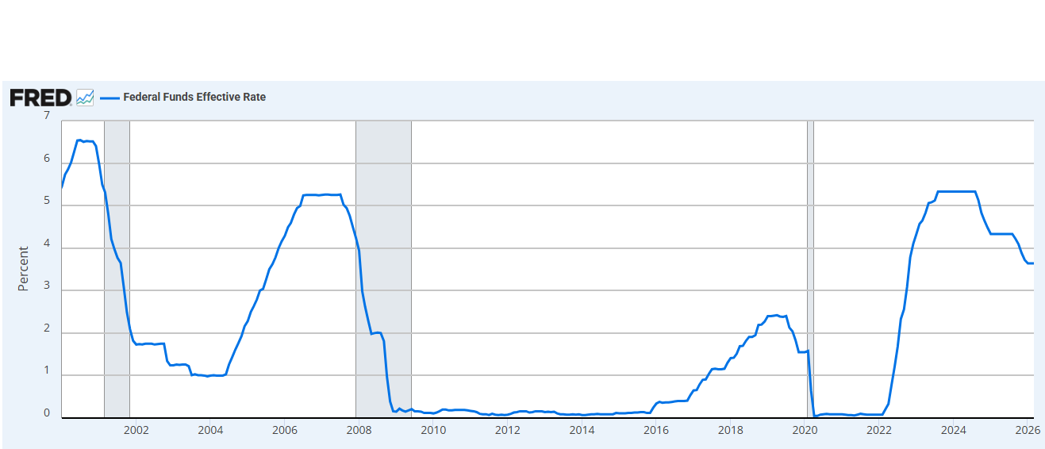
Interest Rate Risk
What is Interest Rate Risk? Interest rate risk refers to the potential for adverse changes in interest rates to impact bank’s profitability, asset values, and financial performance. For instance,
Net Interest Margin (NIM): Bank makes money primarily by borrowing funds at lower short-term rates (e.g., deposits, short-term loans) and lending those funds at a higher long-term rates (e.g., mortgages). When interest rate rises, the cost of funds increases more quickly than the yield on assets, compressing the net interest margin. Conversely, when interest rate falls, the net interest margin tends to widen.
Asset and Liability Mismatch: Bank typically has mix of fixed-rate and variable-rate assets and liabilities. If a bank’s assets, such as loans, have longer maturities than its liabilities, such as deposits, it faces the risk that rising interest rate will lead to a decline in the values of its assets relative to liabilities.
Empirical Evidence: In last decades, monetary policy plays a crucial role in shaping bank’s asset composition and profitability by influencing interest rates. Literature shows policy-induced interest rate increases lead banks to switch to a more expensive mix of funding sources, affecting bank profits.
Fig 1. Historical Fed Funds Rate
Fig 1. shows several sharp turns in the federal funds rates, reflecting the Federal Reserve’s efforts to adapt its monetary policy stance to changing economic conditions and risks. However, many studies suggested that monetary policy may have been overly aggressive (Adrian, Erceg and Natalucci 2023, Bernanke 2015, Lachman 2018, Stone 2023), which might lead uncertainties to banks.

Slide 15
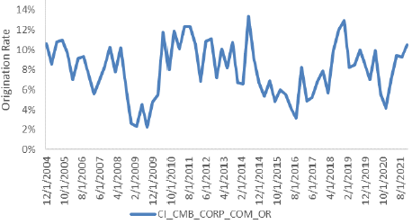
Strategic Risk
What is Strategic Risk?
Strategic risk for a bank refers to the potential effects on earnings or capital arising from the bank’s strategic decisions, initiatives, or the changing business environment.
Example - How strategic risk would affect business through modeling channel?
CMB corporate loans mainly come from middle market clients with revenues mostly driven within U.S - more than 92% of clients are located within U.S. Those clients, as suggested by business, have high sensitivity to U.S. recessions and economy cycle given corporate size and ability to pay debt.
Fig 2. Historical CMB Corporate Loan Origination Rate
Strategy
GFC
Fig 2. shows that the historical data for origination rate is generally volatile with macroeconomic environment (i.e., the Great Recession, COVID period)
Frequent strategy revision is seen in recent years. Since 2015, the portfolio was influenced by RWA reduction strategy, and the origination rate was around 6% on average between 2015 – 2017. In 2019, the bank has decided to strategically grow the CBM business, hence an origination rate jump is observed in 2019.
Impact: Improper modeling approach without the consideration of strategic shifts might deliver unreliable stress testing results, and thus bias bank’s impact assessment and capital planning processes.
COVID
Strategy

Slide 16
Model Validation
Steps and common challenges

Slide 17
PPNR Model Validation Steps
Data
Data sources, data extraction and preparation, data relevance, data reconciliation, data quality, etc
Design
Model scope and objective, modelled portfolio/products, model methodology selection, key assumptions and methodology, portfolio segmentation relevancy, variable selection, model performance, final model selection, etc.
Performance
Performance analysis, benchmark analysis, sensitivity analysis, scenario analysis, conservatism analysis, backtesting analysis, performance monitoring thresholds, rank ordering, etc.
Re: statistical models: Independent variables significance, variable intuitiveness, multicollinearity, stationarity, cointegration, structural breaks, integration order, autocorrelation, heteroscedasticity, normality, etc.
Implementation
Model implementation into production environment, EUC, change control, post-implementation model monitoring, etc
Documentation
Quality of documentation, auditability
Monitoring
Model monitoring plan and its execution, tests, thresholds, actions, RAGs

Slide 18
Modeling Data
What are the minimum data requirements to build a robust model that is suitable for CCAR exercise?
Inherent data limitation
Ideal solutions: Time series data including a full economic cycle, data quality check, proxy data…
The model has been developed on 2016-2022 data series. This training sample does not cover full economic cycle as the market downturn period is not included. Model out-of-sample performance metrics have been calculated on the benign period (Q1-Q3 2023). Thus, the model performance under actual historical market stress period could not be assessed.
Modeling Approach
Statistical models are powerful with desired framework, but qualitative approaches can also be appropriate given proper framework. Based on US PPNR model inventory, statistical approaches are adopted for 10% of model in use, while 90% of models are based on non-statistical approaches, such as judgmental, mathematical, discounted cashflow methodologies
 | Strength | Limitation
Statistical Approach | Data driven model with strong variable selection process Easy to back-test, including performance in stress periods Supported by statistical testing results | Aligning to business strategy might result in overlays Not able to capture all recent changes in business mix Comparatively more volatile historical data granularity limits model performance May request large sample size to ensure robustness of testing results
Non-statistical Approach | Can reflect business strategy change Intuition based, easier for business to provide input and challenge Could incorporate conservatism | Difficult to validate key assumptions and monitor them Might rely on simple correlation analysis and historical trend observations

Slide 19
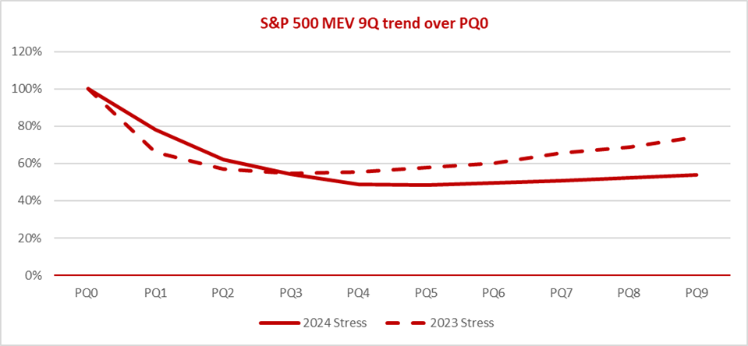
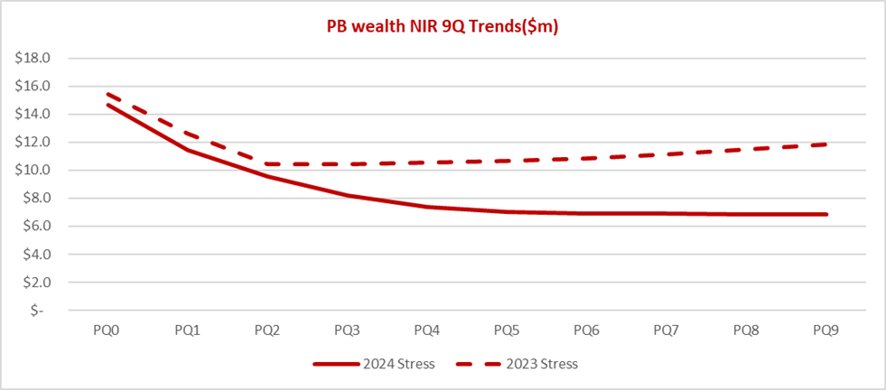
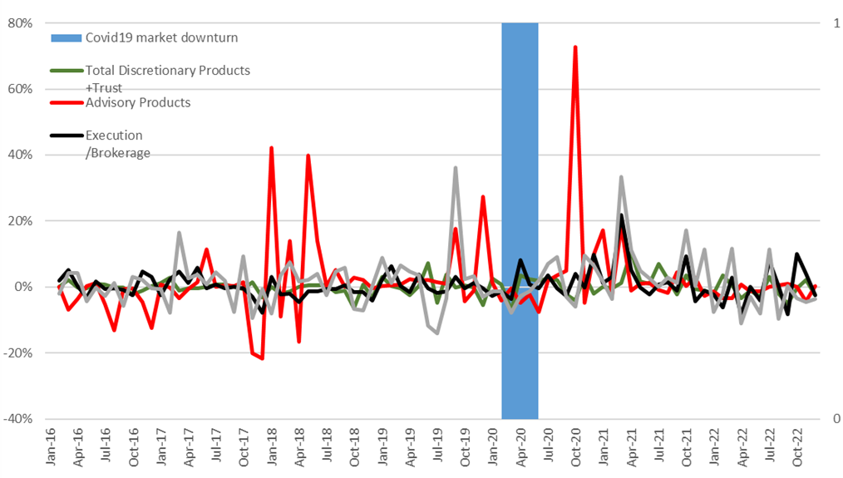
Model Example – Revenue
Model Overview
Name: HBUS WPB NIR model
Purpose : Project Net Interest Revenue in market stress conditions for different product lines of the HBUS private bank segment.
Model methodology: based on simple analytical approach, 6-month rolling average (for Net New Money and Spread projection), and the change of the underlying macro-variable (for Asset Under Management projection). The macro-variable selected for all product lines is a share price index - S&P Stock Price Index: 500 Composite.
Issues: model development data did not cover full economic cycle, alternatie methodologies not considered, macro-variable (SP500) selection not justified, implicit assumption of linear and proportional change in macro-variable-asset, flat Net New Money projection.

Slide 20
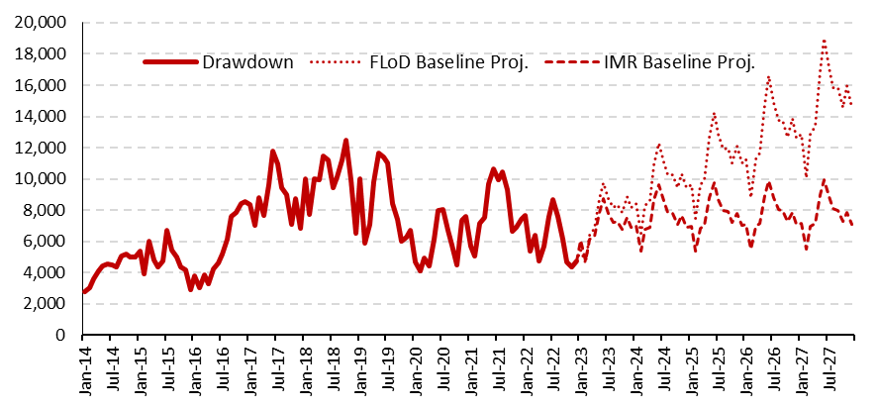
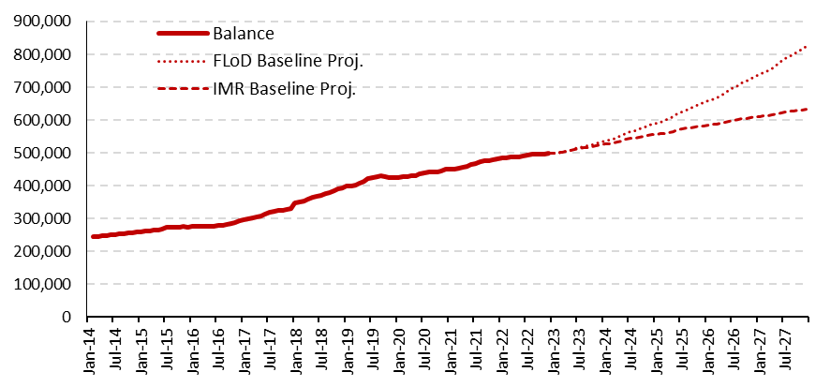
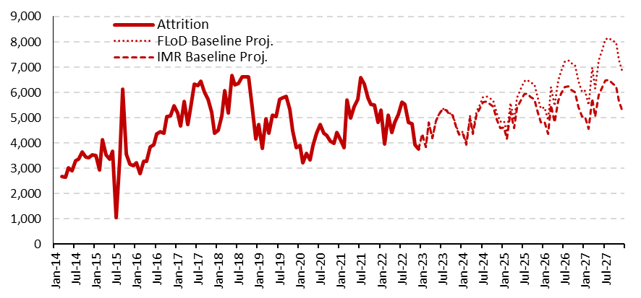
Model Example – Balance
Model Overview
Name: AMH Core WPB Mortgage Balance Sheet Projection Model
Purpose: To estimate future monthly end of period balance volume of HSBC China mortgage portfolio in the 5-year forecasting horizon.
Model methodology: The balance level is driven by the two modelled components – drawdowns and attrition, and the actual data – the T0 balance and macroeconomic data (Real Gross Domestic Product, House Price Index) serving as a model input. The methodology followed is statistical – linear regression used for drawdown estimation, and analytical – 12-month average used for attrition estimation.
Issues: Real GDP shows historical non-stationarity generating artificial trends on dependent variables.

Slide 21
Disclaimer
This presentation has been prepared by HSBC Service Delivery (Polska) Sp. z o.o. with a registered office located at Kapelanka 42A, ​
30-347 Kraków, Poland, registered in the District Court for Kraków-Śródmieście in Kraków, XI Commercial Division of the National Court Register, under the number KRS 0000310459, share capital (entirely paid) in the amount of 67 689 500,00 PLN, NIP 525-242-91-07, hereinafter referred to as “HSBC”. ​
​
HSBC has based this document on information obtained from sources it believes to be reliable but which has not been independently ​
verified. While this information has been prepared in good faith, no representation or warranty, express or implied, is or will be made ​
and no responsibility or liability is or will be accepted by the HSBC, or by any of their respective officers, employees or agents in relation​
to the accuracy or completeness of the Documents or any other written or oral information made available to any interested party or its advisers and any such liability is expressly disclaimed. Any charts and graphs included are from publicly available sources or proprietary ​
data. No liability is accepted whatsoever for any direct, indirect or consequential loss arising from the use of this document. HSBC is under ​
no obligation to keep current the information in this document. You are solely responsible for making your own independent appraisal of ​
and investigations into the data, products, financial instruments and transactions referred to in this document and you should not rely on ​
any information in this document as constituting investment advice. Neither HSBC nor any of its affiliates are responsible for providing you with legal, tax or other specialist advice and you should make your own arrangements in respect of this accordingly. The issuance of and details contained in this document, which is not for public circulation, does not constitute an offer or solicitation for, or advice that you ​
should enter into, the purchase or sale of any security, commodity or other financial instrument or master agreement, or any other contract, agreement or structure whatsoever. This document is intended to be distributed in its entirety. Reproduction of this document, in whole or in part, or disclosure of any of its contents, without prior consent of HSBC or any associate, is prohibited.​

Slide 22
References

Slide 23
References
Bernanke, Ben, and K. Kuttner (2005): “What explains the stock market’s reaction to Federal Reserve policy?”, Journal of Finance, Vol 60, Issue 3, pp 1221-1257
Demirguç-Kunt, A, and H. Huizinga (1999): “Determinants of commercial bank interest margins and profitability: some international evidence”, The World Bank Economic Review, vol 13, no 2, pp 379-408
English, William, S. Heuvel, and E. Zakrajsek (2018): “Interest rate risk and bank equity valuations”, Journal of Monetary Economics, Vol 98, pp 80-97
FED, SR11/7: Guidance on Model Risk Management. The Fed - Supervisory Letter SR 11-7 on guidance on Model Risk Management -- April 4, 2011
Ken Heinecke, FRB. PPNR/Balance Sheet Modeling. https://www.bostonfed.org/-/media/Documents/events/STM/first/heinecke.pdf
McKinsey&Company. Developing robust PPNR estimate. https://www.mckinsey.com/~/media/mckinsey/dotcom/client_service/risk/pdfs/developing_robust_ppnr_estimates.ashx
Moody’s Analytics. What if PPNR Research Proves Fruitless? https://www.moodysanalytics.com/risk-perspectives-magazine/risk-data-management/regulatory-spotlight/what-if-ppnr-research-proves-fruitless

Slide 24
Thank you

